Slide 1

WRDPNTRS
NEW SHOOTS PROGRAM 2021
UBC & Vancouver School Board
Kathleen & Sonia

Slide 2




Ekphrastic Poetry
communication between two art mediums
What is it ?
Art & Poetry
having a conversation between
WORDS and a PIECE of ART
painting, video, film clip, drawing, sculpture

Slide 3
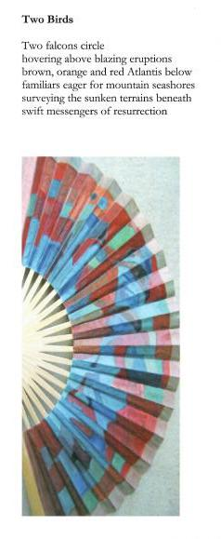
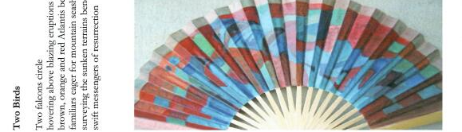
Examples of Ekphrastic Poems

Slide 4
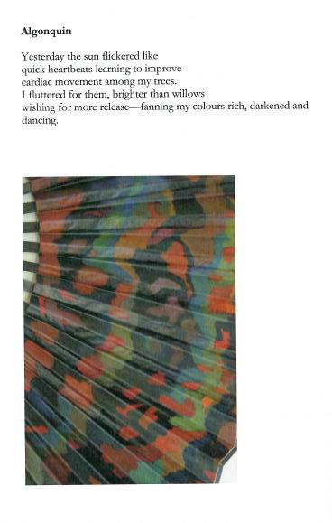
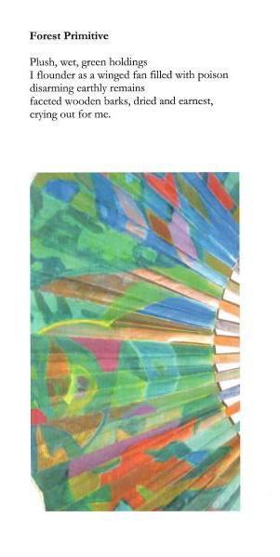
Forest Primitive
Chapbook by Poet Sonia Di Placido & Artist Holly Briesmaster

Slide 5
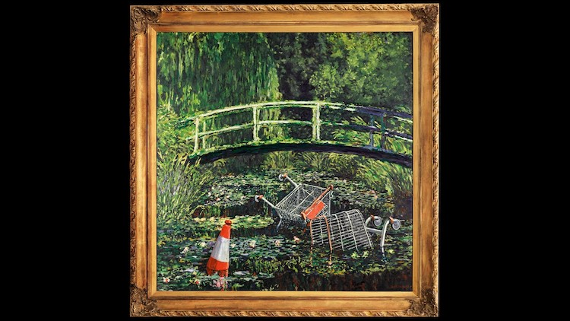
Show me the Monet Banksy

Slide 6
Video of Banksy
https://youtu.be/EsLJiYalb6I
https://www.ekphrastic.net/ekphrastic-journal/show-me-the-monet-by-mike-mesterton-gibbons
(video about Monet and Banksy)
Write your own Ekphrastic Poem
Sharing
Thoughts
Ekphrastic Journal
https://www.ekphrastic.net/

