Slide 1


EMILY DICKINSON
American Poet, Amherst, Massachusetts

Slide 2

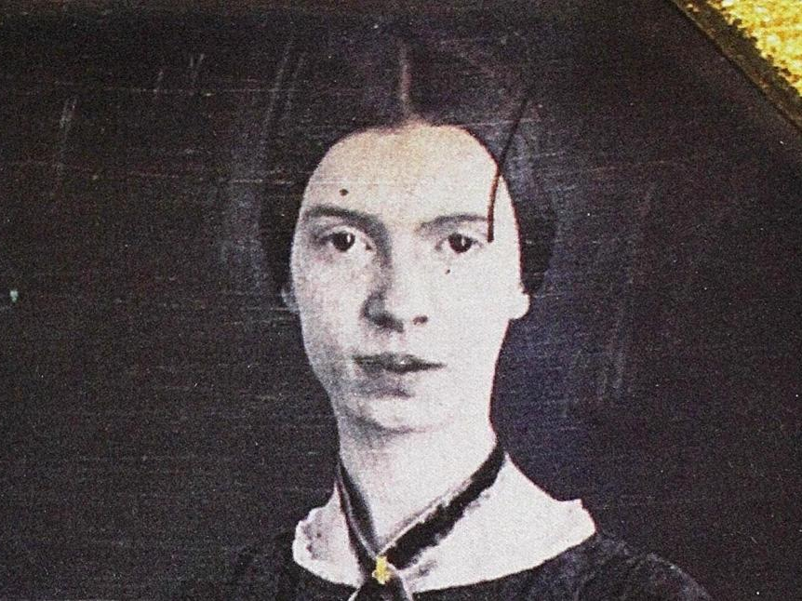
I am Nobody
I’m Nobody! Who are?
Are you – Nobody – Too?
Then there’s a pair of us!
Don’t Tell! they’d advertise – you know!
How dreary – to be – Somebody!
How public – like a Frog –
To tell one’s name – the livelong June –
To an admiring Bog!
Circa 1861

Slide 3
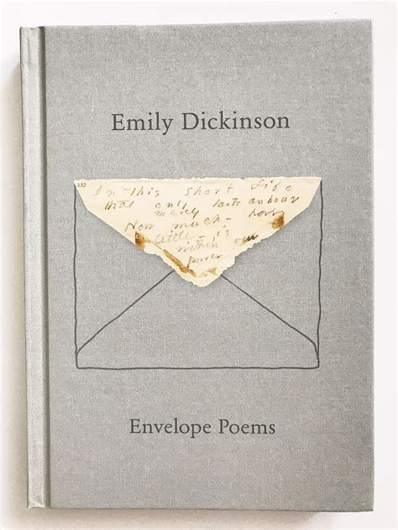
Emily Dickinson, Poet
https://www.poetryfoundation.org/poets/emily-dickinson
https://www.ndbooks.com/book/the-gorgeous-nothings/

Slide 4
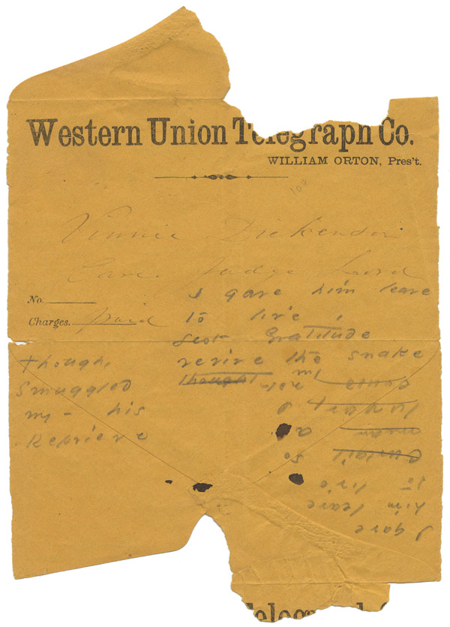
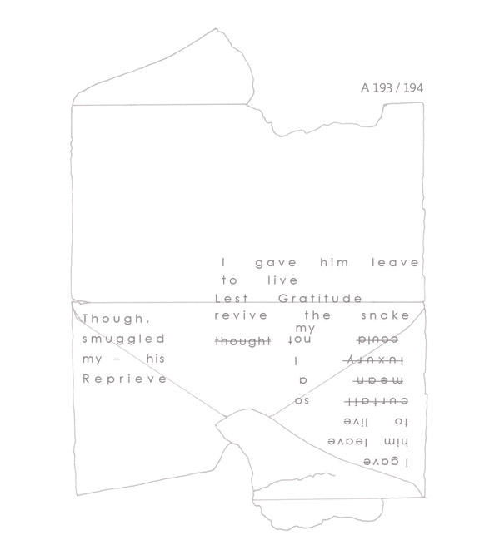
A193/194
I gave him leave to live

Slide 5

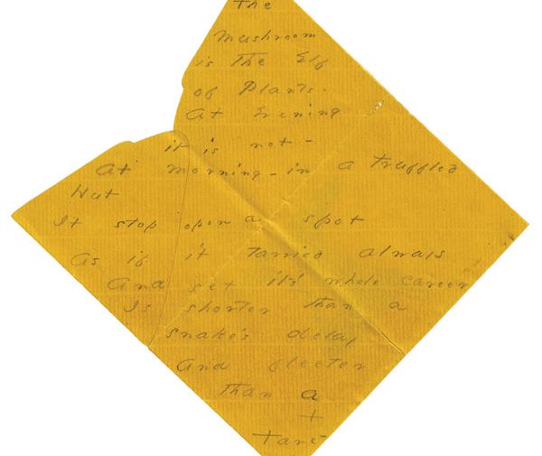
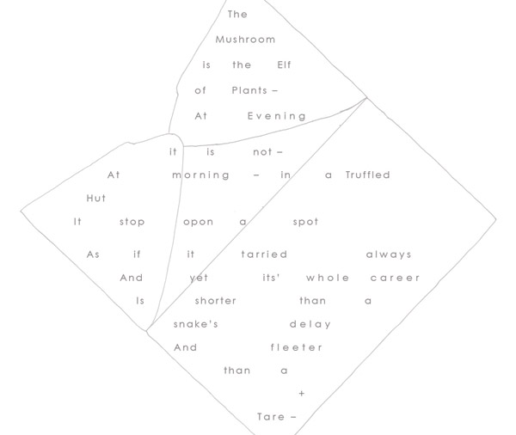
The Mushroom is the Elf of Plants –

