Slide 1

WRDPNTERS
Looking at Art, Looking back with Poems

Slide 2
Day 4:
Poetry Comics

Slide 3
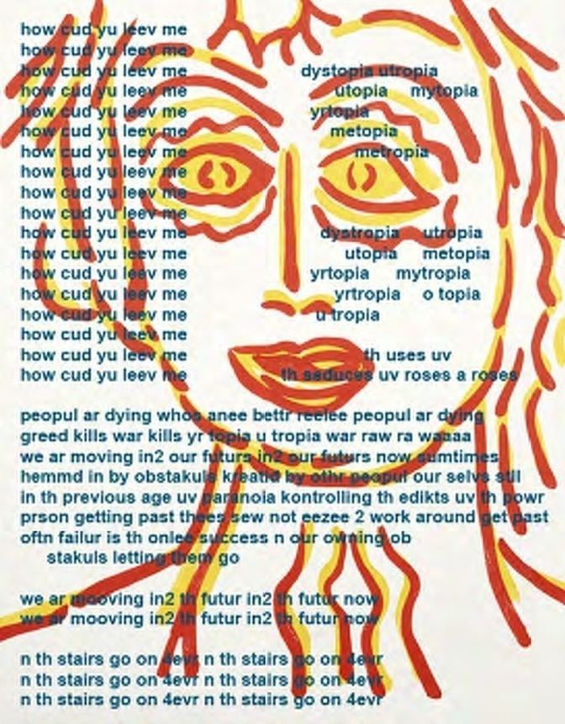
Bill Bissett
Bill Bissett is a Canadian poet, writer, and artist utilizing the style of concrete poetry and subverting conventional orthography.
He is known for his unusual language use and incorporation of visual elements into his poetry.
Themes in his work range from the mystical to the mundane, incorporating humour, sentimentality, and political commentary.
In 2007, Bissett was awarded the George Woodcock Lifetime Achievement Award for outstanding contributions to literature in British Columbia.
https://www.billbissett.com/html/billtheartist.htm
https://talonbooks.com/books/breth

Slide 4
looking at my work yu can c i was alwayze aware uv th stroke th image in th stroke th lettr n th lettr stroke in th line n th image drawing breth from th watr th erth n th air n th
fire
th pickshurs th lettrs wuns wer n th changing rhythms n th being aneewher th bcumming is alwayze changing as is th context each stroke each breth each line each breth each lettr each line breething each rhythm cadens phrasing each melodee uv th
line
recent books
b r e t h / th treez
uv lunaria
selektid rare n nu pomes 1957-2019 talonbooks

Slide 5
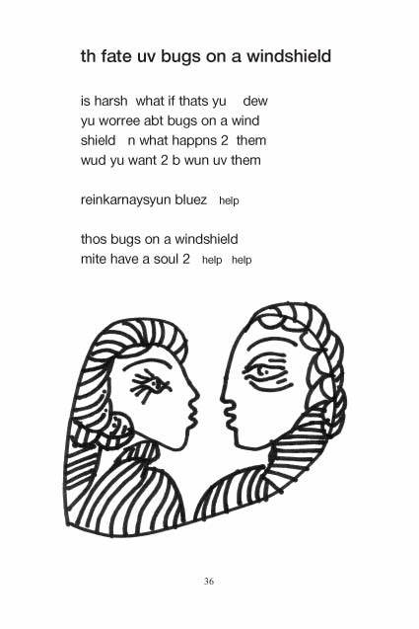
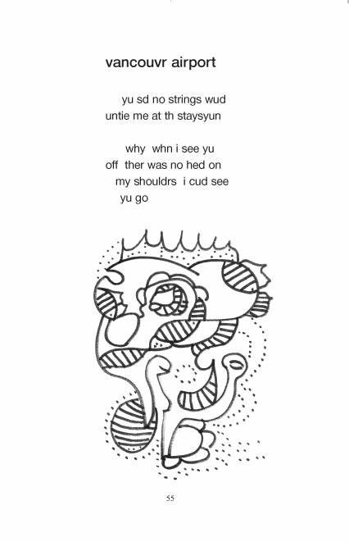

Slide 6
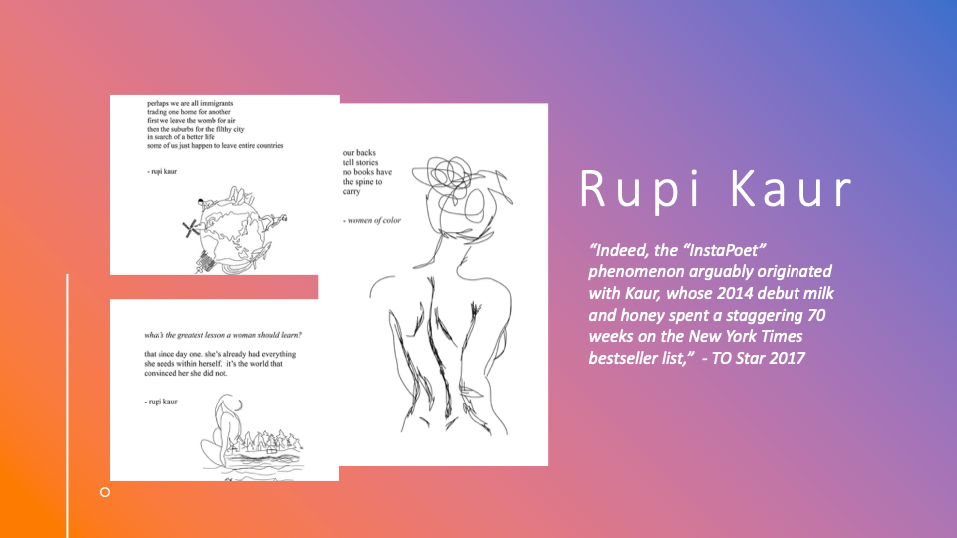

Slide 7


Slide 8
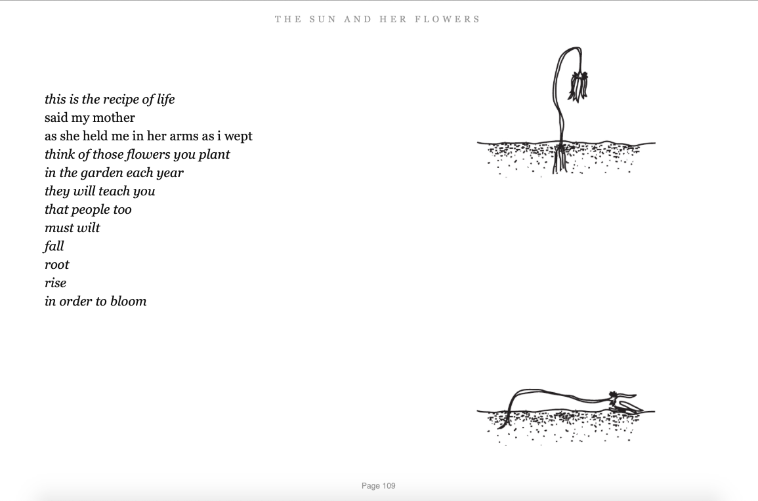
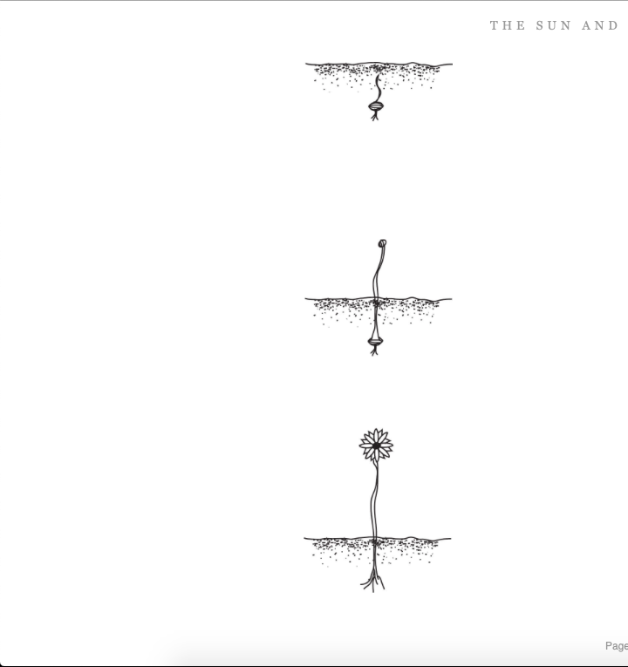

Slide 9
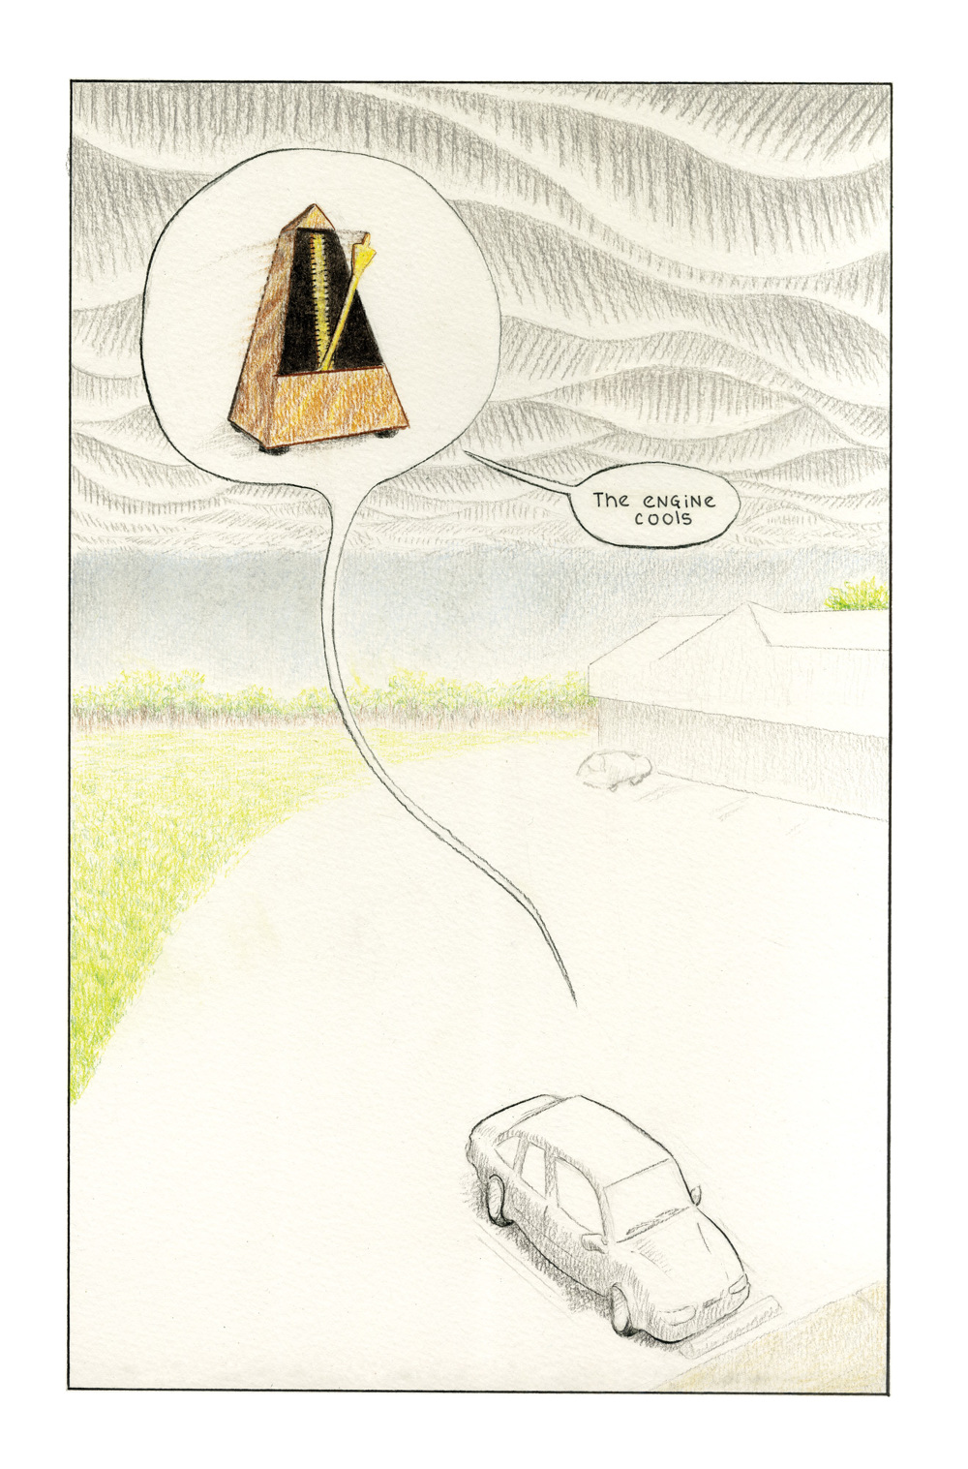
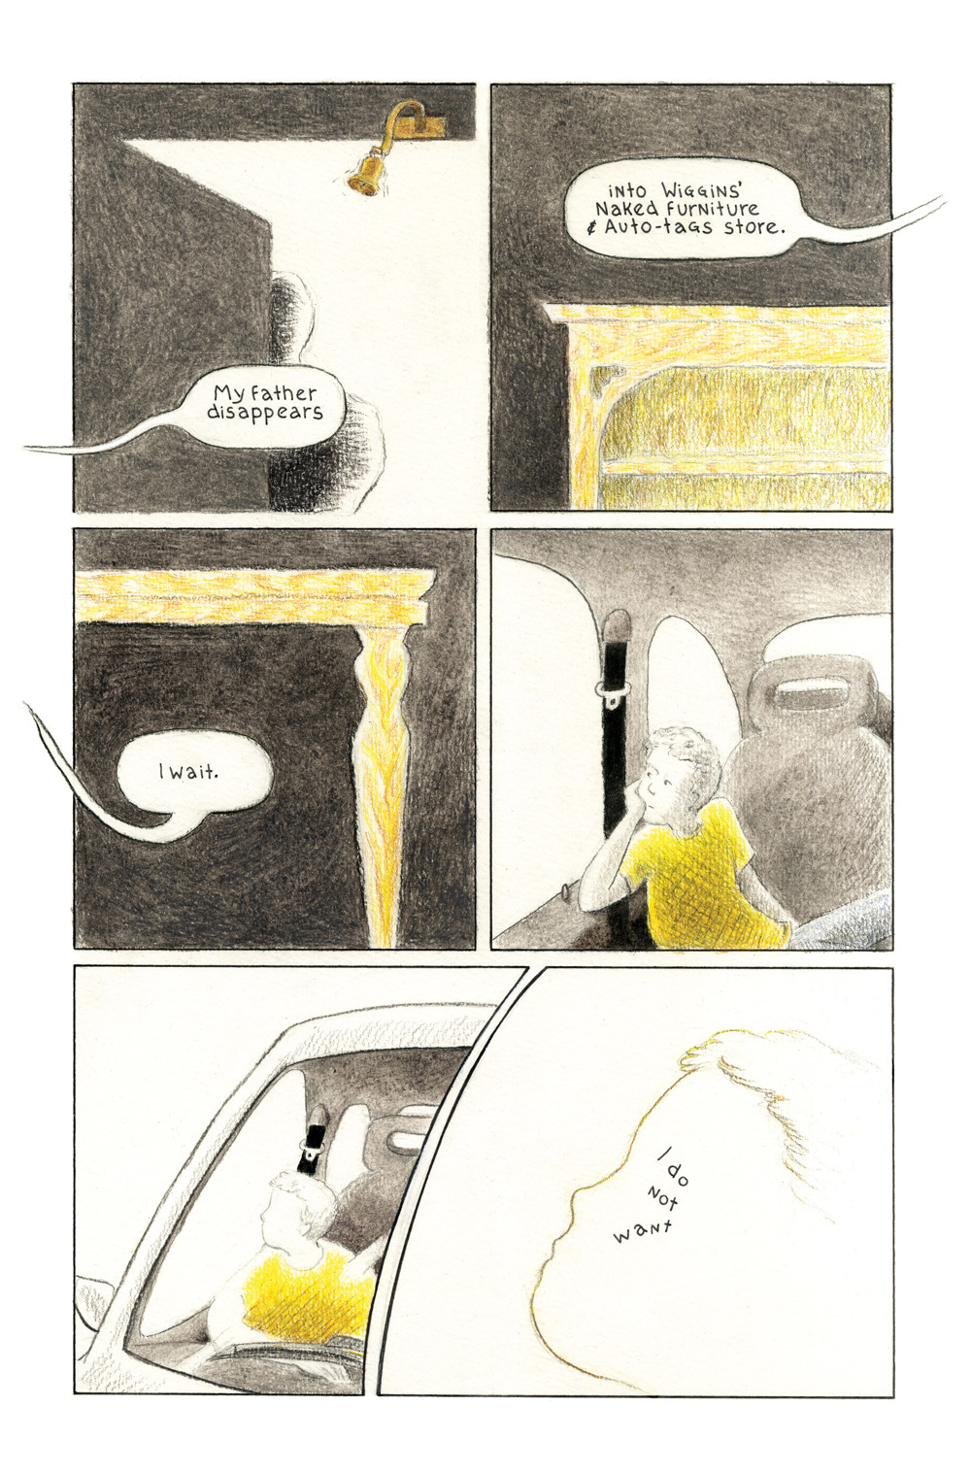
Alexander Rothman, Excerpt from “Keeping Time”
First published in INKBRICK NO. 1, 2014.
Visit Rothman’s website to see full comic

Slide 10
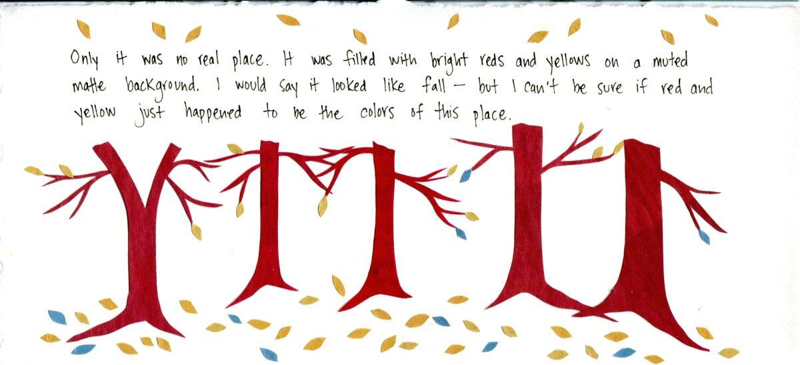
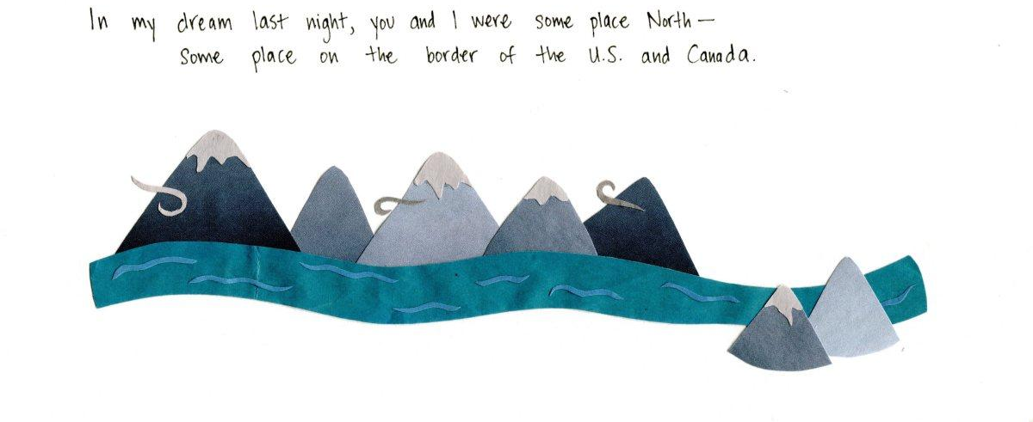
Mita Mahato, Dream (n.d.)

Slide 11
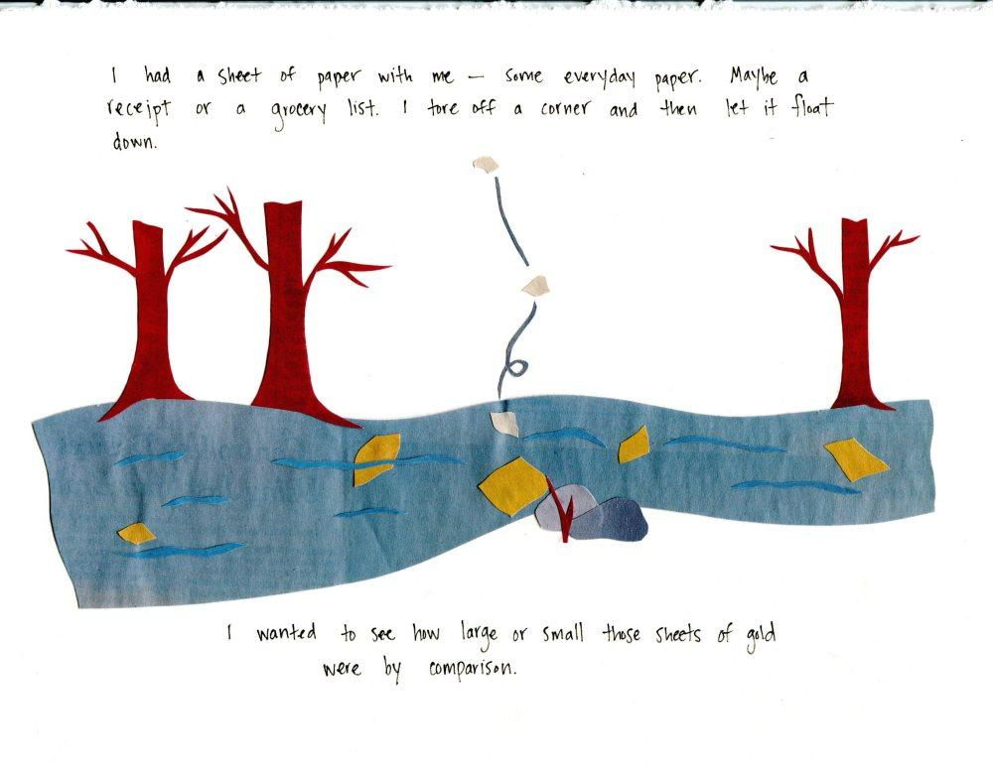
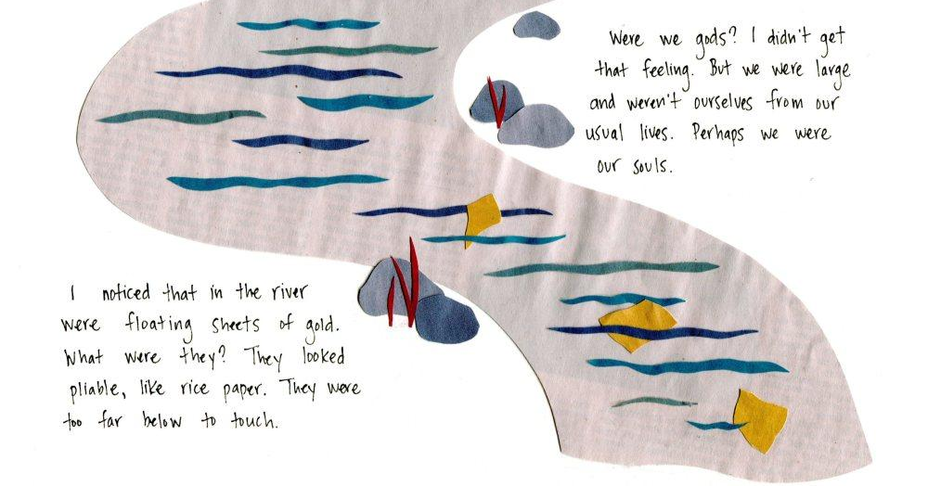
Mita Mahato, Dream (n.d.)

Slide 12
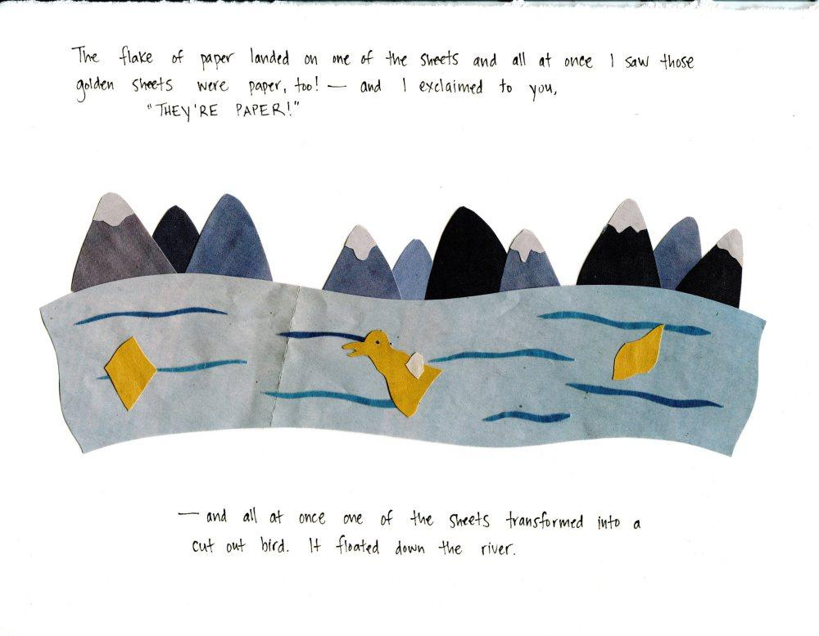
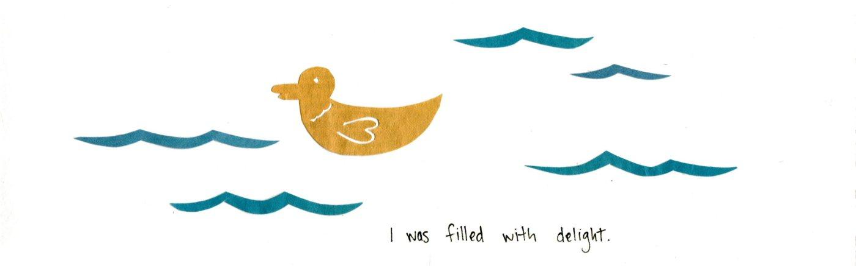
Mita Mahato, Dream (n.d.)

Slide 13
What do you notice about Poetry Comics
Splash page
Negative space
Captions
Speech bubbles
Materials
  Pen
  Pencil/pencil crayon
  Ink
  Collage (paper cut outs and glue)

Slide 14
Activity
Make a poetry comic using three to four panels inspired by:
    Alexander Rothman OR Mita Mahato

Slide 15
Using
Pen / Pencil / Pencil Crayons
Paper cut outs
(from scrap, magazines, construction paper, receipts, etc...)
Glue

Slide 16

Share

Slide 17
Anthology
Submit your poems and your short biographies to [Ricardo and Emily?] by [?]

Slide 18
More to love
http://www.thedreamingmachine.com/brethfest-tribute-to-bill-bissett-on-his-80th-birthday-part-i-intro-by-adeena-karasick-writings-by-mla-chernoff-steve-clay-and-lance-strate/

Slide 19
More to love Alexander Rothman
“Keeping Time” https://versequential.com/Comics-Poetry/Keeping-Time-INK-BRICK-no-1
https://indianareview.org/2015/06/what-is-comics-poetry-by-alexander-rothman/
https://inkbrick.com/about

Slide 20
More to love Mita Mahato
https://theseframesarehidingplaces.com/
https://shenandoahliterary.org/681/lullaby/
https://shenandoahliterary.org/681/mita-mahato-feature/

